Slide 1

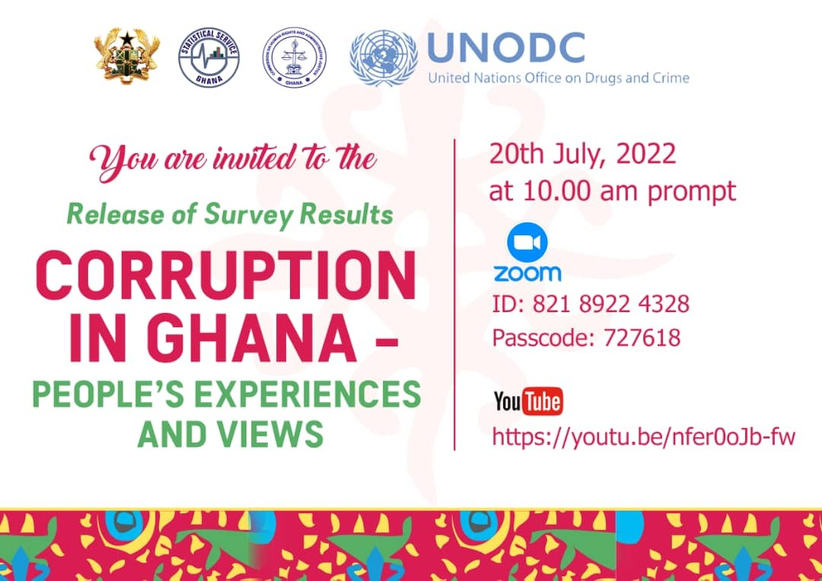

Slide 2
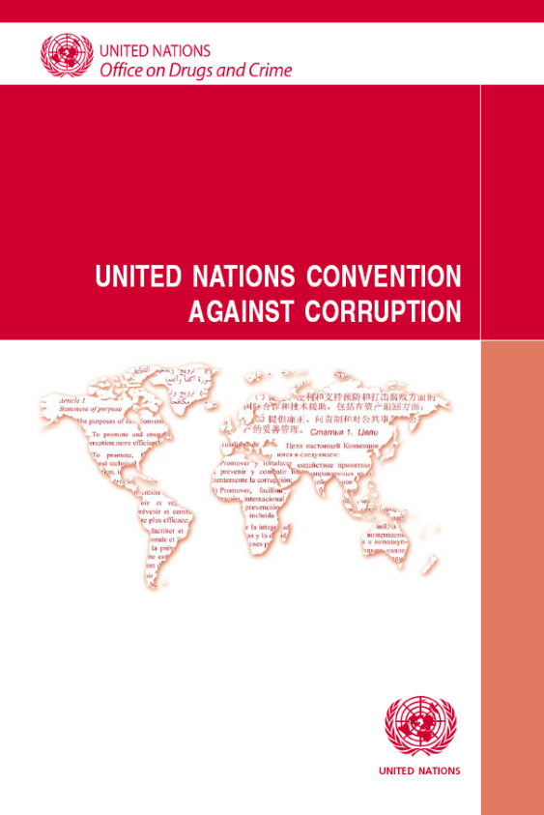

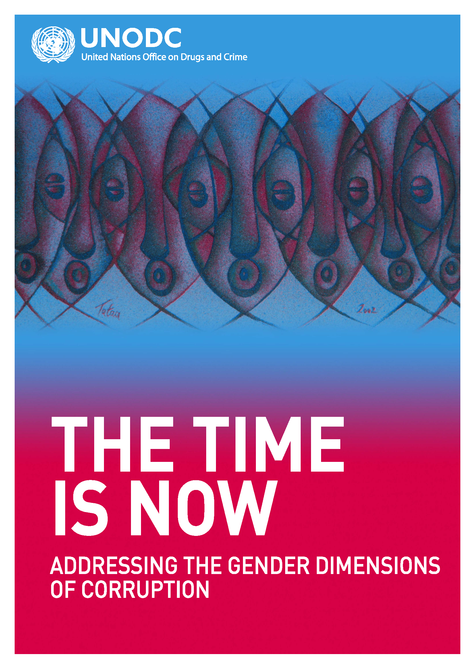
Mandates and work
Guardians of UNCAC
Secretariat of the UNCAC Implementation Review Mechanism
Thematic areas of work

Slide 3
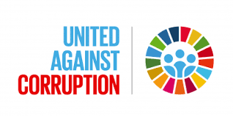

Promote peaceful and inclusive societies for sustainable development, provide access to justice for all and build effective, accountable and inclusive institutions at all levels
16.5 Substantially reduce corruption and bribery in all their forms
UNODC is the guardian of this and other indicators – thus provide technical assistance to this end

Slide 4
Outline
Background
Methodology
Results
“Glimpse of trends”
Key messages
Next steps

Slide 5
Background
SDG Indicators
16.1.4: Proportion of population that feel safe walking alone around the area they live after dark
16.3.3: Proportion of the population who have experienced a dispute in the past two years and who accessed a formal or informal dispute resolution mechanism, by type of mechanism
16.5.1: Proportion of persons who had at least one contact with a public official and who paid a bribe to a public official, or were asked for a bribe by those public officials, during the previous 12 months
Efforts are nationally driven
NACAP
Previous and recent surveys
Notes:
The Ghana Governance and Corruption Survey Evidence from Households, Enterprises and Public Officials in 2016 – “the percentage of citizens who paid bribes in the
course of dealing with the listed institutions. Customs division of the GRA (76%), the DVLA (74%), the Passport Office (63%) and the Ghana Police Service (61%) top the list of institutions where citizens paid bribes.”

Slide 6
Methodology (1/4)
Target population: Adults aged 18 and older
  Household-level information also available
Data was collected in December 2021 to January 2022
Sampling
  National and regional representation
  District and type of residence
  Selection of EAs (1500)
  Selection of Households (15000)
  Selection of Adult respondents (15,000 - 14,843)
Validation
Computation, and reference period and target respondents for the indicators

Slide 7
Methodology (2/4)
The survey instrument was structured as follows:
Socio-economic information about the respondents
Attitudes, opinions, and perceptions about corruption
Experiences with accessing public sector services and experiences of bribery
Reporting of bribery
Experiences with accessing private sector services and experiences of bribery
Nepotism and favouritism in public sector recruitment, promotion, and access to public services
Vote-buying
Awareness and opinions on specific anti-corruption agencies
Perception of safety and security
Access to justice
*Gender Dimensions

Slide 8
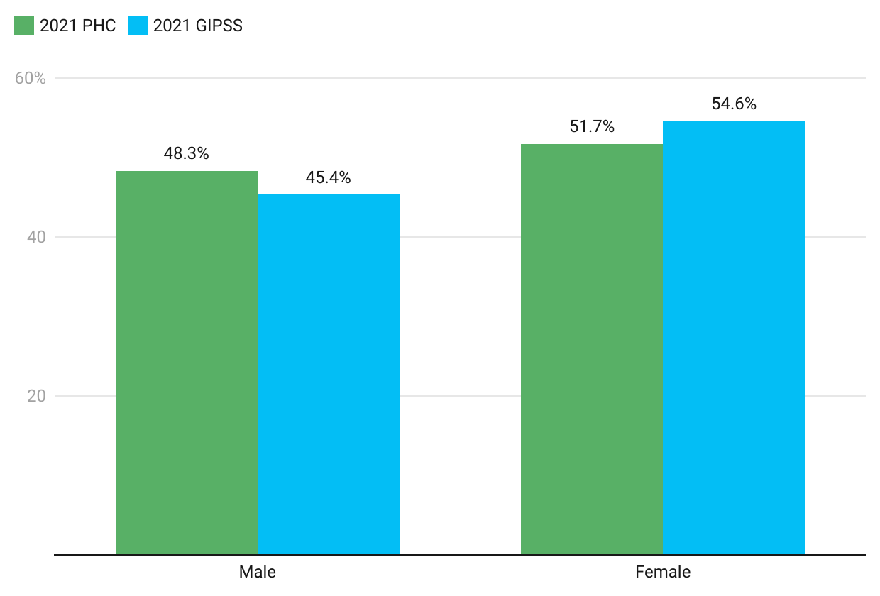
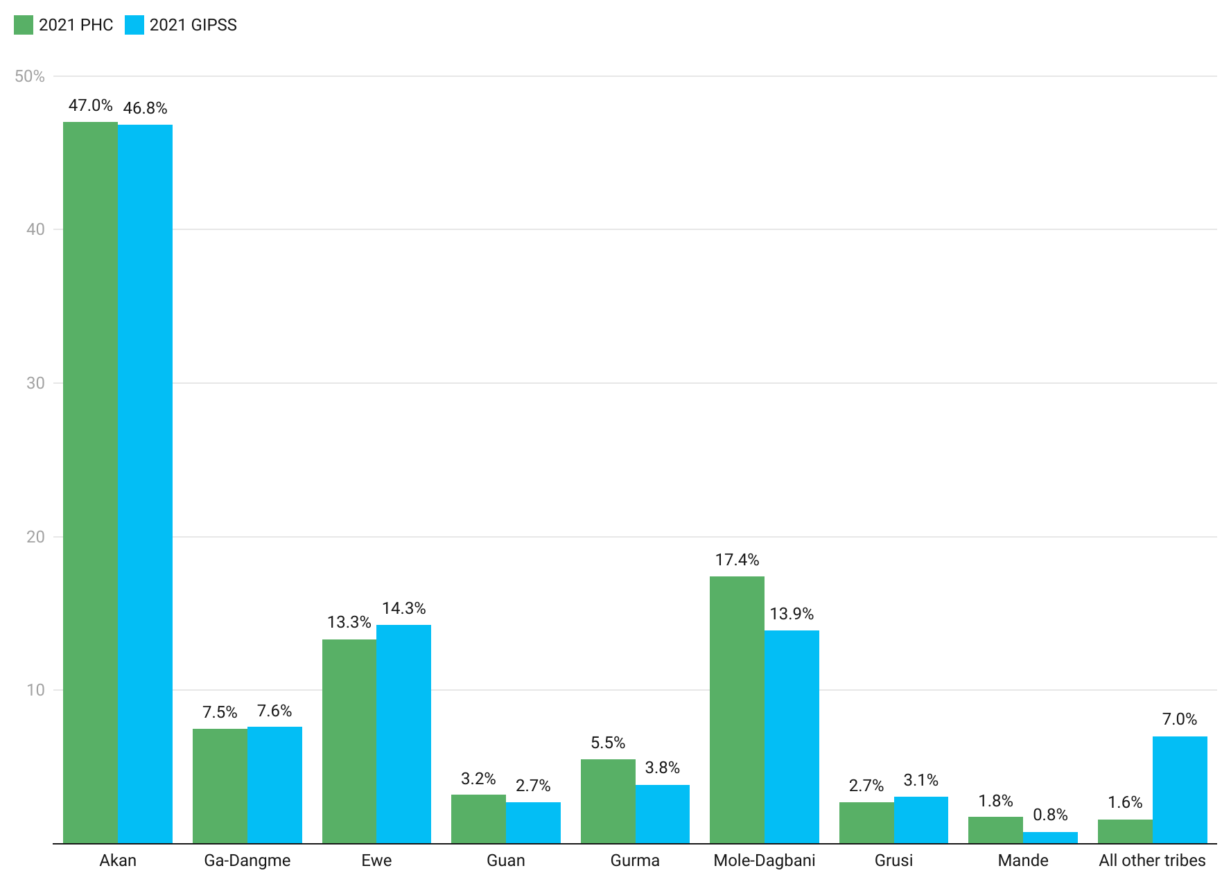
Methodology (3/4)

Slide 9
Methodology (4/4)

Slide 10
Scope of Bribery

Slide 11
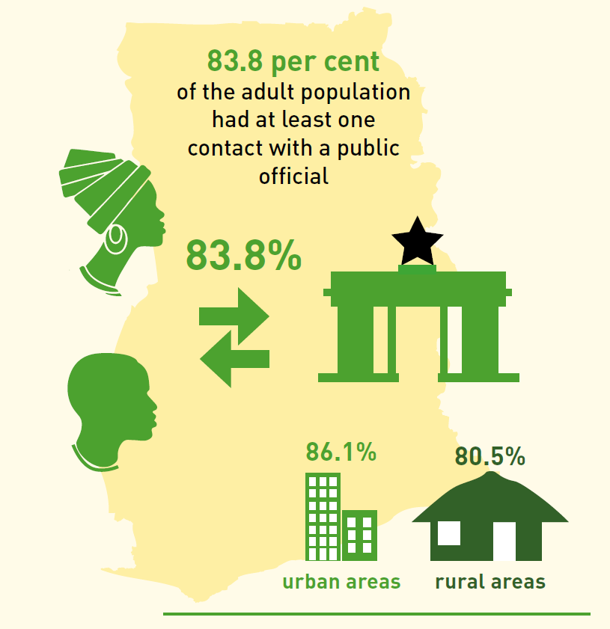
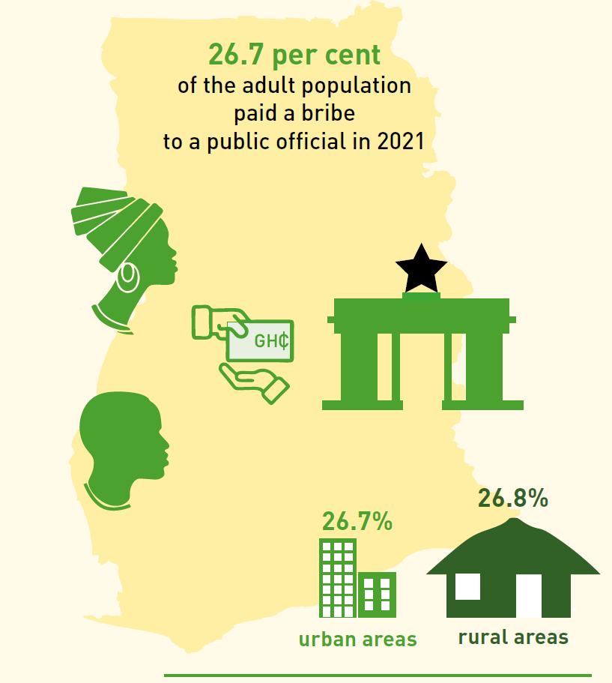
Scope of Bribery (1/6)
Notes:
The survey shows that more than 8 out of 10 adults in Ghana had at least one contact with a public official in 2021.
Some 64.8 per cent interacted with those public officials more than once, indicating that interaction between the public and those who are employed in Ghana’s public institutions is widespread and well-established.
Out of all adults who had at least one contact with a public official in 2021, 26.7 per cent paid a bribe to a public official, or were asked to pay a bribe
by a public official but refused to do so.

Slide 12
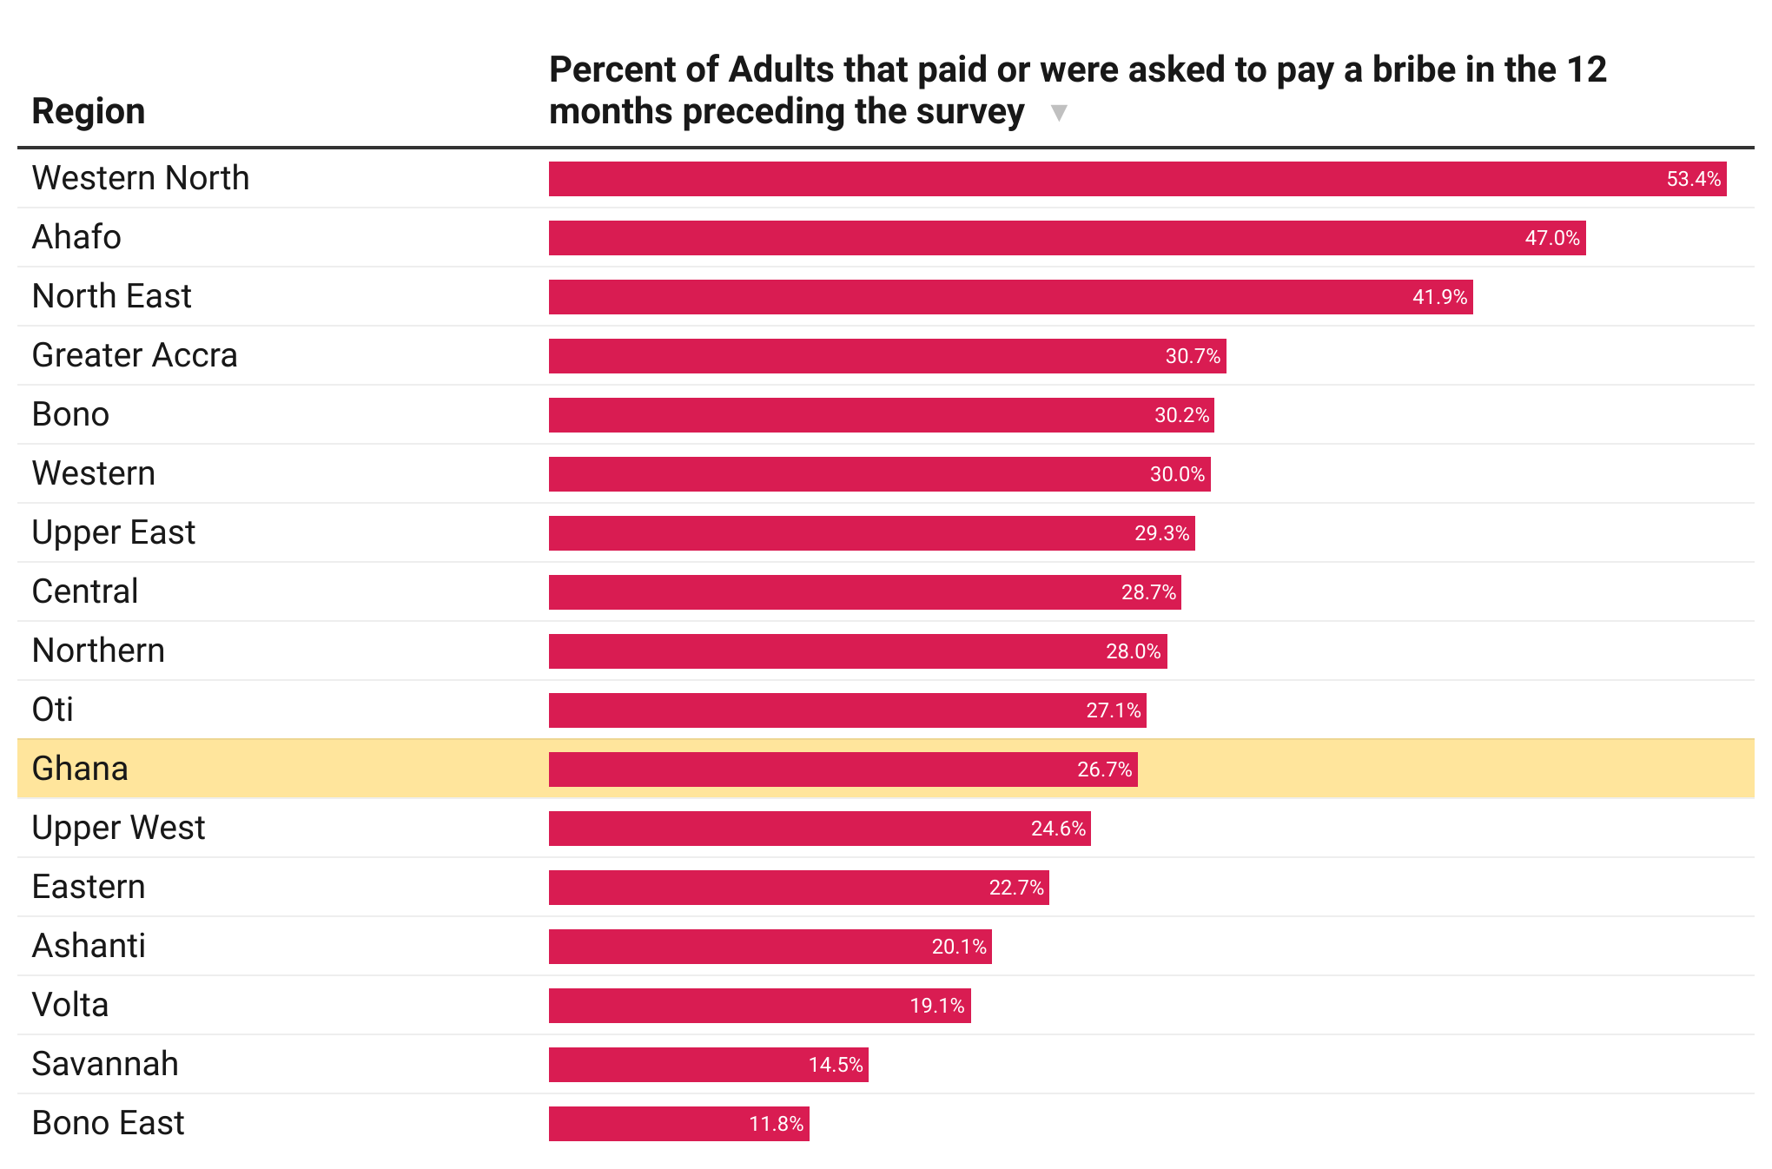
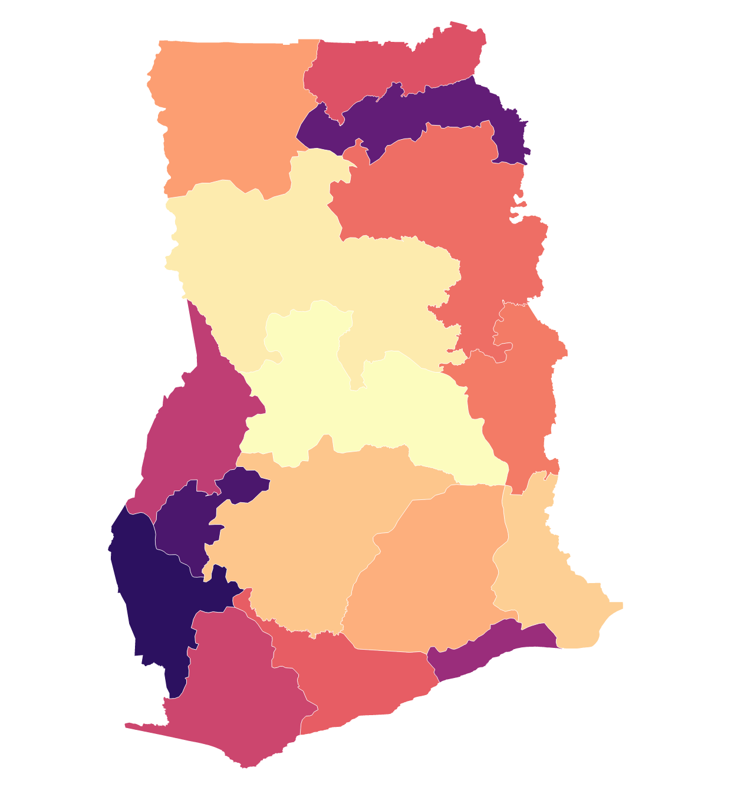
Scope of Bribery (2/6)
Notes:
10 out of the 16 administrative regions recorded prevalence of bribery higher than the national average.
There are, however, sizable variations across the 16 regions of the country. The prevalence of bribery in the Bono East, Savannah and Volta regions, for example, is substantially lower than the national rate, at 11.8, 14.5 and 19.1 per cent, respectively, while in the Western North, Ahafo and North East regions it is substantially higher, at 53.4, 47.0 and 41.9 per cent, respectively.

Slide 13
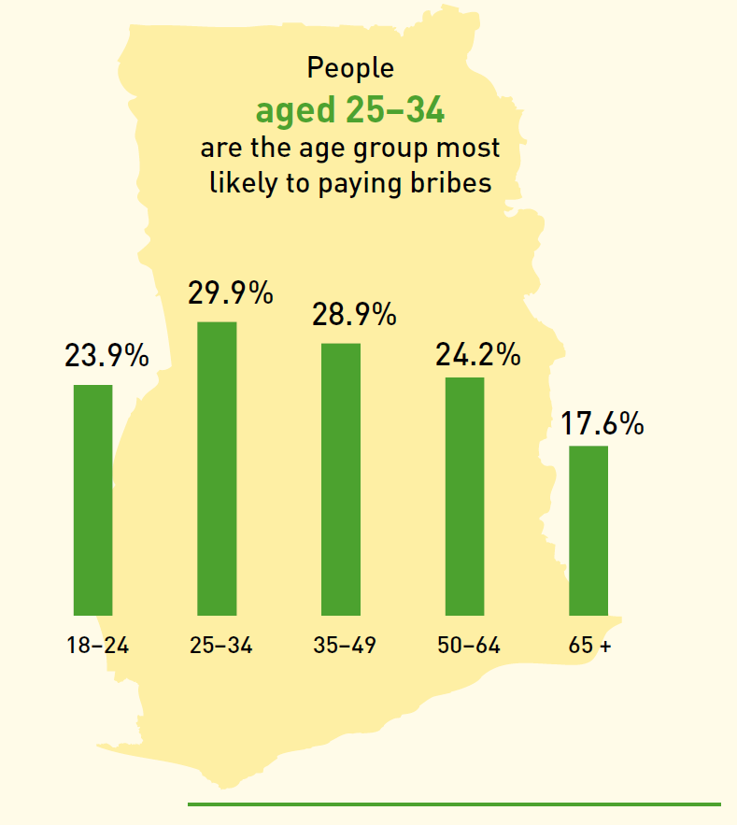
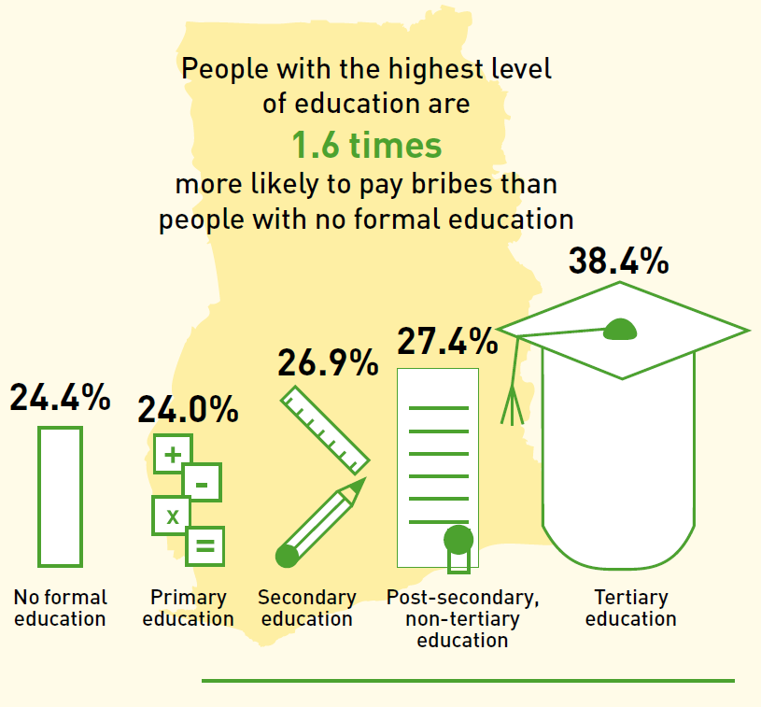
Scope of Bribery (3/6)
Notes:
With a prevalence of bribery of 29.9 per cent, people aged 25–34 are the age group most vulnerable to paying bribes. The prevalence of bribery
decreases steadily to 17.6 per cent among those aged 65 and over, while among the youngest adult age group (18–24) it is 23.9 per cent
With a prevalence of bribery of 38.4 per cent, Ghanaians with a master’s degree and/or a bachelor’s degree are much more likely to have been asked to pay a bribe than those with no formal education. According to the survey, people with the highest level of (tertiary) education were 1.6 times more likely than people with no formal education to have paid a bribe, or been asked to pay a bribe but refused to do so, when in contact with a public official.

Slide 14
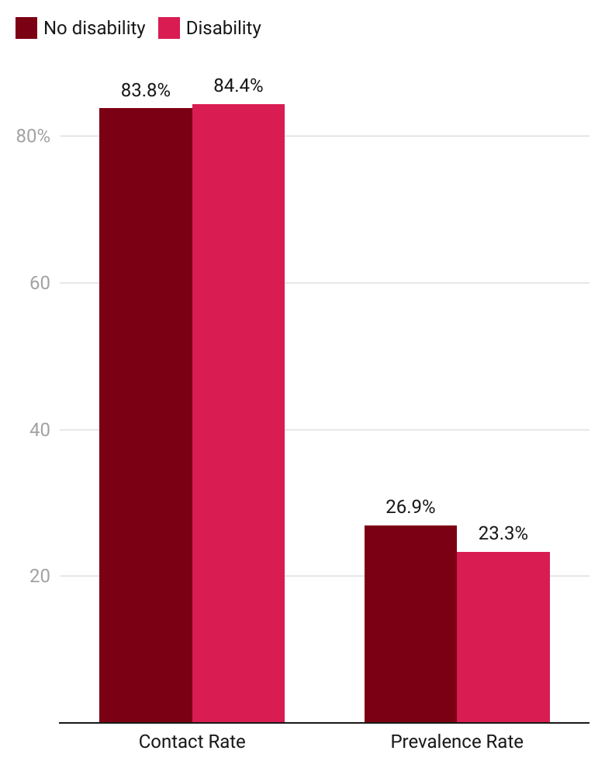
Scope of Bribery (4/6)
Prevalence of bribery by disability status
Notes:
Prevalence of bribery among persons with without disability (26.9%) is higher than people disability (23.3%)

Slide 15
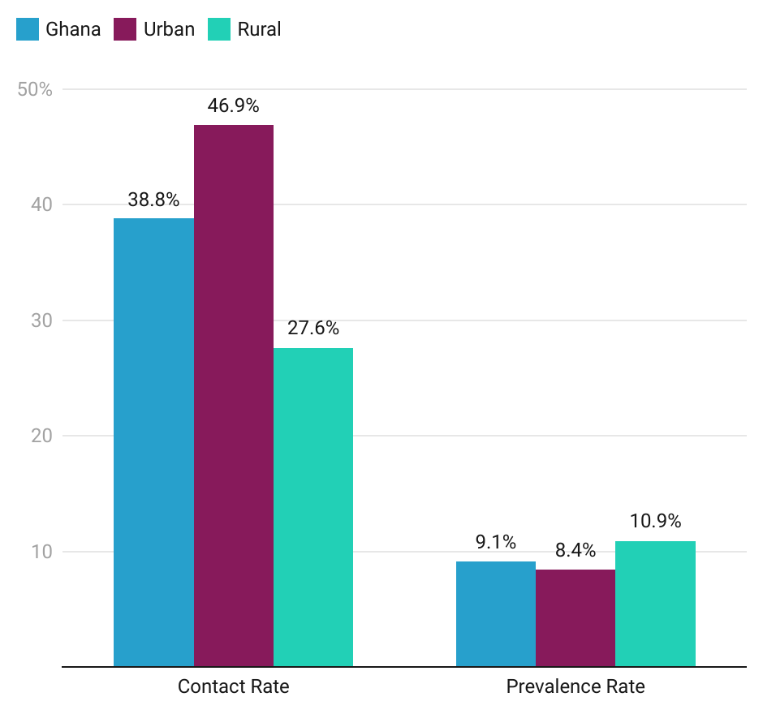
Scope of Bribery (5/6)
Prevalence of bribery in the private sector

Slide 16
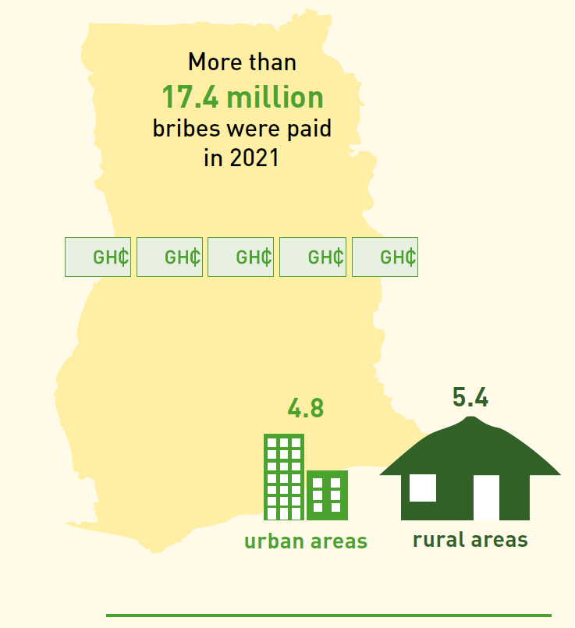
Scope of Bribery (6/6)
Notes:
Bribe-payers paid an average of 5 bribes in the 12 months prior to the survey, resulting in an average of 0.98 bribes paid per adult in Ghana in 2021. This means that more than 17.4 million bribes were paid in Ghana in 2021

Slide 17
Who takes Bribes?

Slide 18
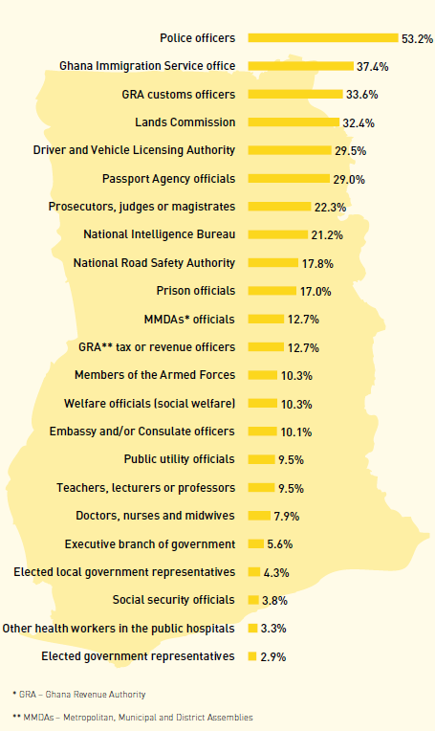
Who Takes Bribes?
Notes:
Prevalence of bribery in relation to police officers is considerably higher than in relation to any other type of public official in Ghana at 53.2%. Ghana Immigration Service Officers and GRA customs officers come next, at 37.4% and 33.6%. Elected government representatives are bottom of the list at 2.9%

Slide 19
How Bribery Works

Slide 20
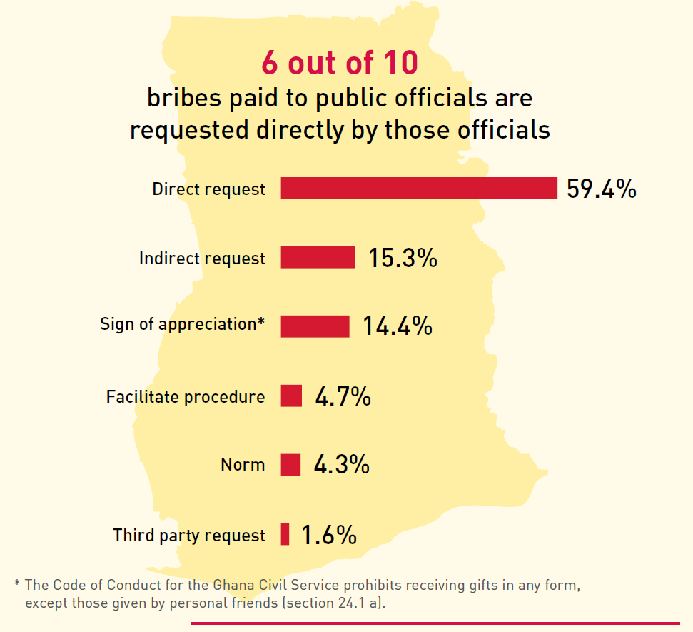
How Bribery Works (1/4)
Notes:
Acts of bribery can be set in motion in different ways. In Ghana, 6 out of 10 bribes paid to public officials are requested directly by those officials.
This is an indication that bribes are both common and expected and underlines the bargaining power of public officials, whose position enables them to solicit a payment in exchange for the promise of providing a public service that should be rendered upon request and, on occasion, totally free of charge.

Slide 21
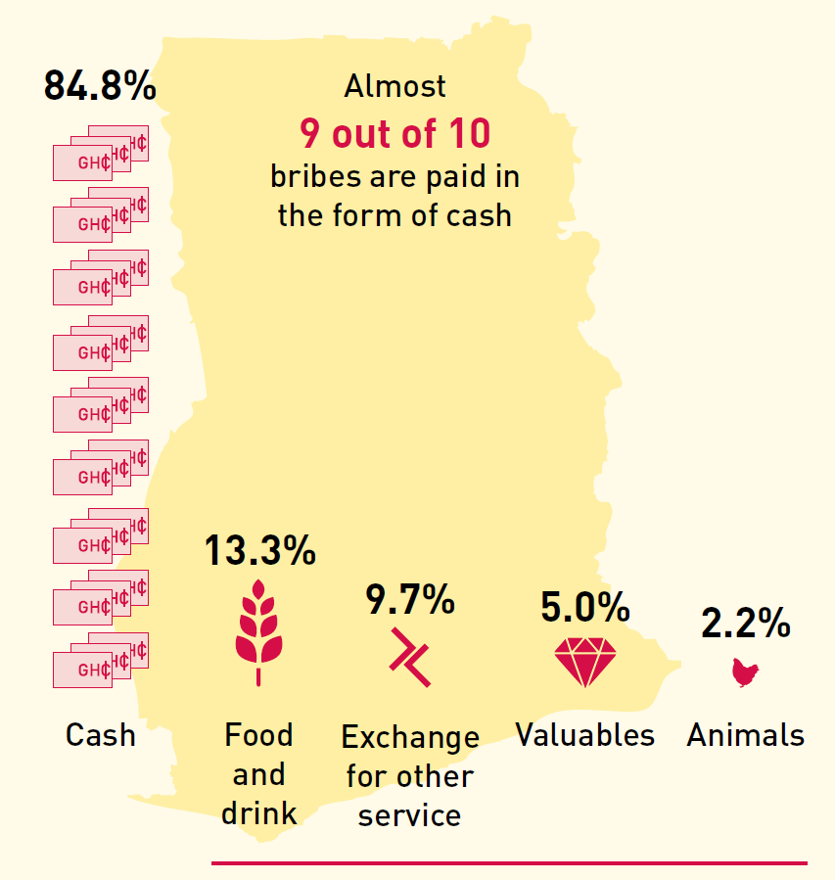
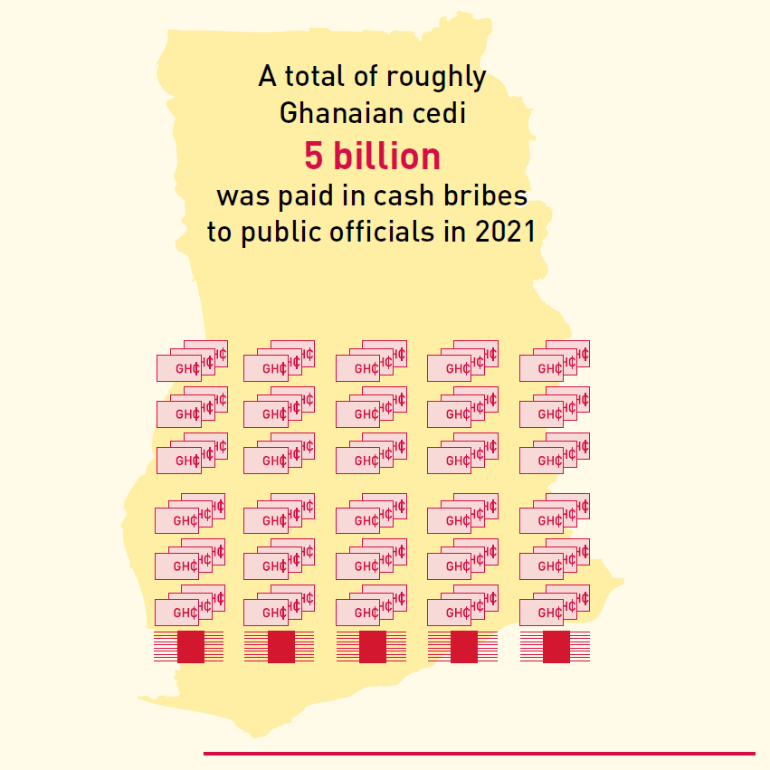
How Bribery Works (2/4)
Notes:
Bribes paid to public officials come in different forms. Almost 9 out of 10 of those paid in Ghana are in the form of cash (84.8 per cent). Food and drink
and the exchange of a public service for another service are far less common, although in the country’s rural areas (17.8 per cent) more bribes are paid in
the form of food and drink than in its urban areas (10.1 per cent).
Cash bribes are 1.5 times larger in urban than in rural areas of the country, with the national average bribe amounting to Ghanaian cedi 348. Given that roughly 17.4 million bribes were paid in Ghana in 2021, a total of roughly Ghanaian cedi 5 billion is paid in cash bribes to public officials on a yearly basis in Ghana, or the equivalent of 32.9 per cent of the 2021 budget of the Ministry of Education.

Slide 22
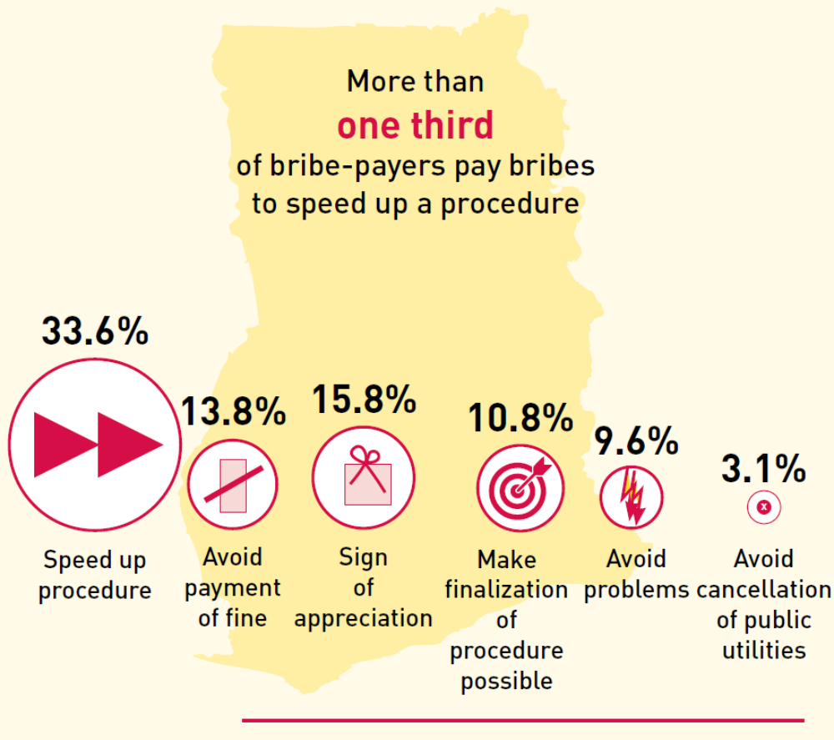
How Bribery Works (3/4)
Notes:
Almost half of all bribe-payers paid a bribe to either speed up or finalize an administrative procedure in 2021 (33.6 per cent and 10.8 per cent,
respectively). This, and the fact that the majority of bribes are directly requested by public officials and are paid in advance of a service, suggests that bribes are paid because people seeking a service are informed by a public official, either implicitly or explicitly, that a procedure will not be processed without the payment of a bribe.

Slide 23
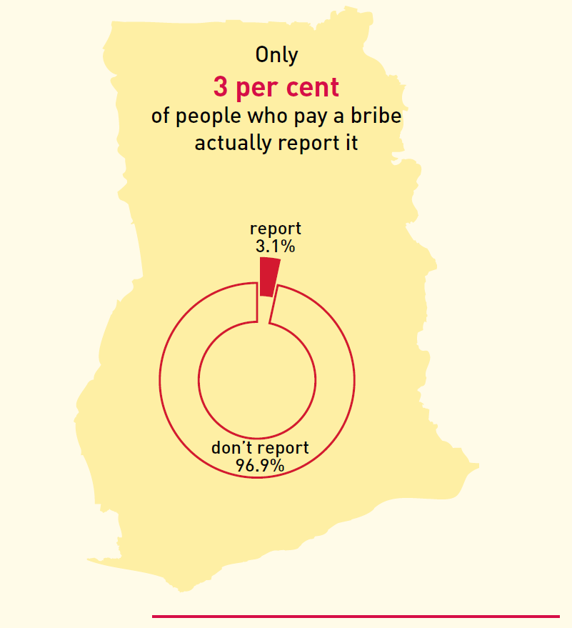
How Bribery Works (4/4)
Notes:
Just 3 out of 100 people who paid a bribe in Ghana in 2021 reported it to an official or an unofficial institution.
The two most common reasons cited for not reporting are that bribery is simply a common practice and people think it pointless as nobody would care.

Slide 24
Gender Dimensions

Slide 25
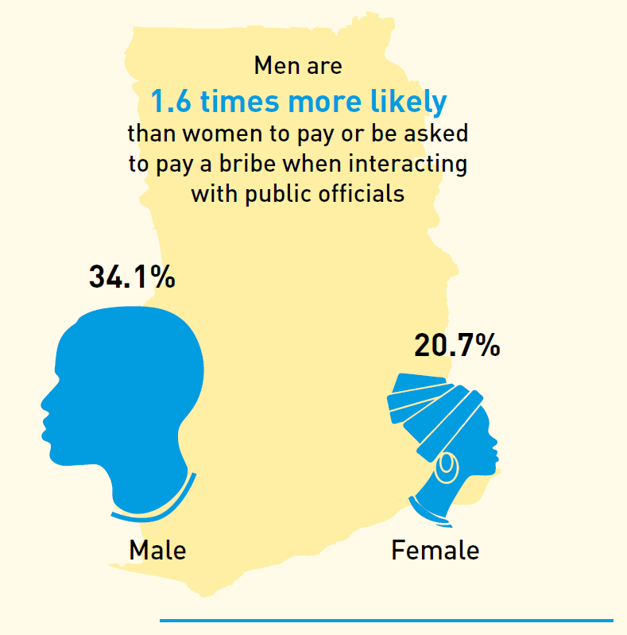
Gender Dimensions (1/3)
Notes:
More than one third (34.1 per cent) of all men who had contact with a public official either paid a bribe or were asked to do so but refused,
while this was the case of one fifth of women (20.7 per cent).
Moreover, women in Ghana are less likely to engage in bribery than men irrespective of where they live, their age, educational background and employment status.

Slide 26
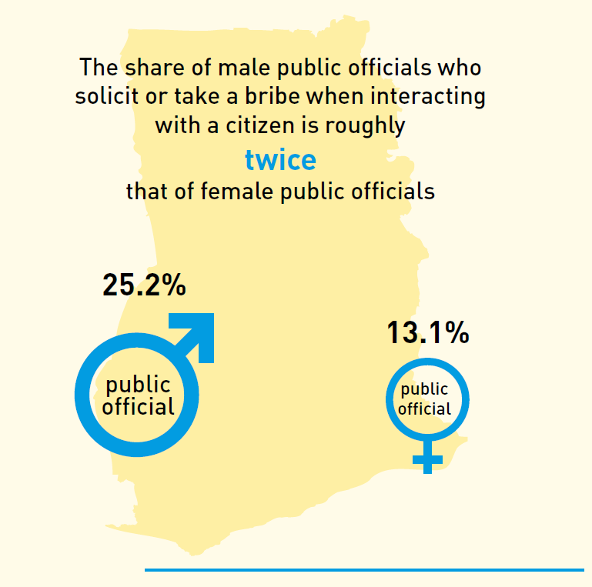
Gender Dimensions (2/3)
Notes:
The share of male public officials who solicit or take a bribe (25.2 per cent) is roughly twice that of female public officials (13.1 per cent). Male public officials are more likely to solicit or take bribes from men than from women, with 61.2 per cent of all bribes resulting from interactions with men. Female public officials, on the other hand, are just as likely to solicit or take a bribe from men as from women.

Slide 27
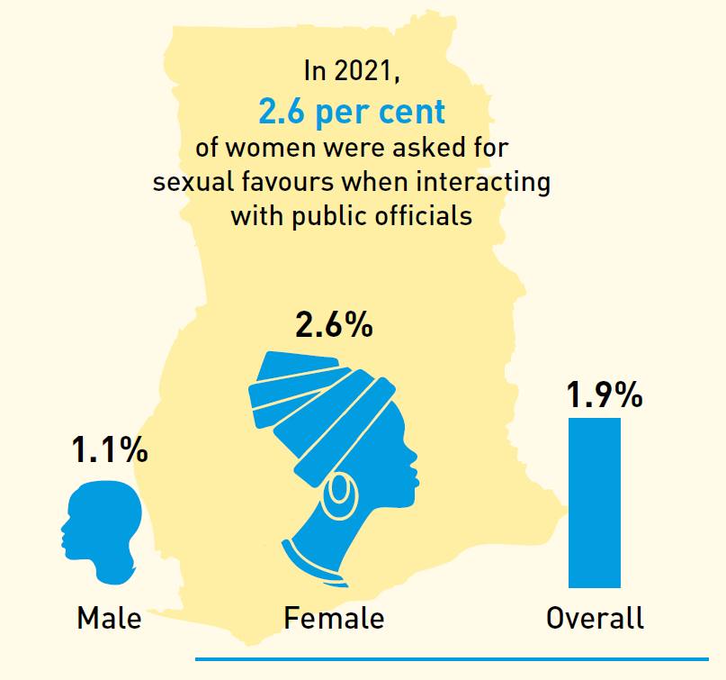
Gender Dimensions (3/3)
Notes:
Sexual corruption – the exchange of sexual favours or acts of a sexual nature in place of monetary bribes – disproportionately affects women in
Ghana, with women being roughly twice as likely as men to be asked for sexual favours when interacting with public officials. In 2021, 2.6 per cent of women in Ghana were asked for sexual favours when interacting with public officials, which is likely an underestimate given the social stigma that surrounds this topic.

Slide 28
Nepotism and Vote-Buying

Slide 29
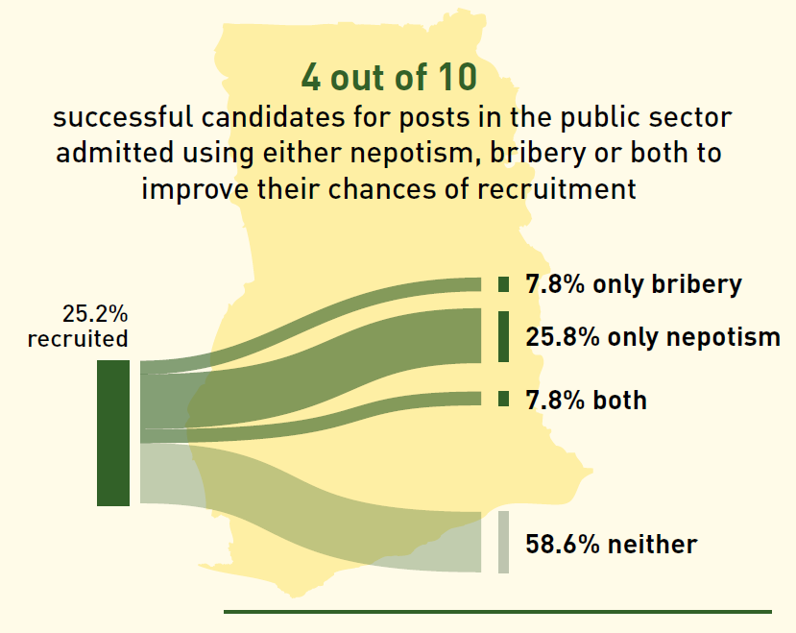
Nepotism and Vote-Buying (1/2)
Notes:
Some 12.7 per cent of respondents or members of their household applied for a public sector post in 2021.
Out of the 25.2 per cent who were subsequently recruited, 41.4 per cent admitted using nepotism, bribery or both to improve their chances of recruitment.
Moreover, it was found that nearly one third (29.0 per cent) of successful applicants had neither sat a written test nor been interviewed before being hired. More importantly, those who had relied on nepotism, bribery or both to obtain their public sector post (40.4 per cent) were more likely to have reported not undergoing any form of assessment than those who had not (21.0 per cent).

Slide 30
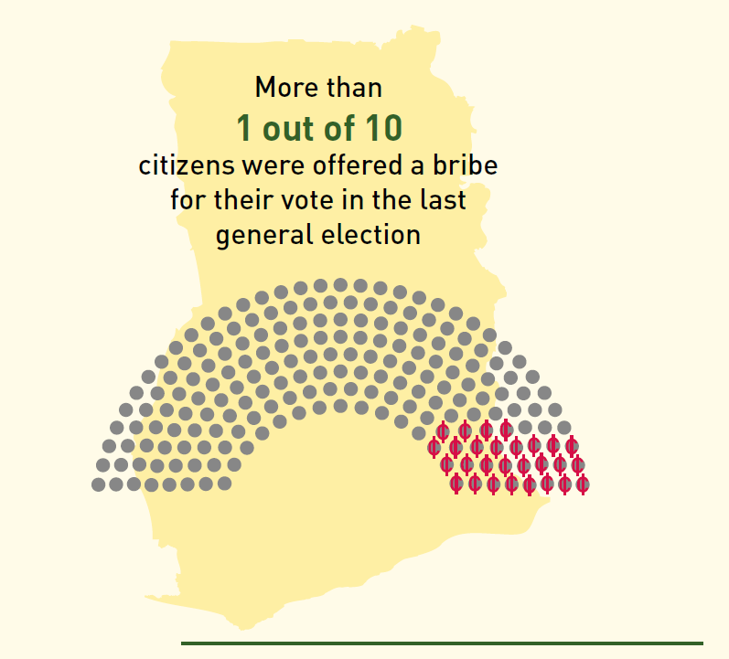
Nepotism and Vote-Buying (2/2)
Notes:
Despite the fact that the electoral process is a core element of a well-functioning democracy, 10.3 per cent of the adult population of Ghana
reported that they were personally offered money or a favour in exchange for their vote before or during the 2020 general election, and a further
4.2 per cent reported that a member of their household was offered money or goods in exchange for their vote. There are substantial regional
differences, however, with 1 in 4 people reporting vote-buying in the Oti region, but just 1 in 11 doing the same in the Eastern region.

Slide 31
“Glimpse of Trends”

Slide 32
Key Messages
Over a quarter of adults (26.7%) paid a bribe in the 12 months preceding the survey
Significant regional variation in the prevalence of bribery from 53.4% in Western North to 11.8% in North East
Gender differences in engagement – males more likely to pay or be asked to pay bribes and male officials are more likely to request bribes
Gender differences in the likelihood of requests for sexual favours when interacting with government officials – 2.6% of females received such requests compared to 1.1% of males;
For the 2020 election, 10.3% of citizens were offered a bribe for their vote; an additional 4.2% of respondents indicated a family member was offered money or goods in exchange for their votes
Approximately GH₵ 5 billion was paid in cash bribes in 2021

Slide 33
Next Steps
Stakeholder engagement at both the national and sub-national levels
Analytical reports
Institutionalise GIPSS
Anti-corruption implementation roadmap

Slide 34
Thank you for your attention
Download full report from https://chraj.gov.gh or https://statsghana.gov.gh

